Slide 1

2.10
Data Organization(Lists and Arrays)

Slide 2

Objectives
To understand how indexing is used to organize data.
To understand concepts of single and multi indexing.

Slide 3
Organizing data
Humans hate disorder.
We try and organize our lives, our cities, our homes and even sometimes
our desks and our bedrooms.
There are many ways of organizing things, and we naturally organize different things in different ways.
The organization we use depends on the things we are trying to organize and often more importantly, what we actually wish to do with them once they are organized.
  Addresses are organized into postal areas so that it is easier for letters to be delivered.
  A bookshop organizes its novels on the shelves usually alphabetically by author.
The way we organize the things we must manipulate to achieve a task can make a massive difference to how quickly, easily or successfully the task can be done.
3
Department of CSE

Slide 4
Game of Spit Not So (Berlekamp et al, 1982)
The game is played as follows by two players:
Write the nine words: SPIT NOT SO FAT FOP AS IF IN PAN on separate pieces of cards.
The cards are placed face up.
Each player takes it in turns to take a card.
To win you must get all the cards that have the same letter.
  For example if you had picked up the cards SPIT, IF and IN, you would have all the cards containing the letter I so would win.
If all the cards are taken with no one having all of a particular letter then the game is a draw.
4
Department of CSE

Slide 5
Play a few games to get then idea, then turn the page to see how a suitable organization will help you play better.
5
Department of CSE

Slide 6
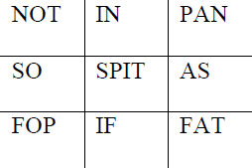
Before you start to play draw up the following grid, with the words that are on the cards written in the squares shown.
The position of each word is important.
They have been organized so that there is a single letter in common in each row, column and diagonal.
All the F-words run along the bottom, for example.
6
Department of CSE

Slide 7
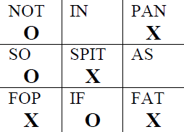
Keep this hidden from your opponent – otherwise they may see the secret.
Play the game exactly as before, except, now each time you pick up a card, put a cross in the square that corresponds to that word.
Put a nought in the squares corresponding to the cards your opponent takes.
For example, the above game will end with your table looking like the following:
7
Department of CSE

Slide 8

Is there a better way to store and access related items?
How should I store the details of all the student names of my class?
  If 60 students in a class can I have 60 different variable names?
    E.g. name1,name2, name3 ……., name60.
Is it organized for efficient access?
Is it easy to be remembered?
What happens if number of students increase from 60 to 80?

Slide 9
Is there a better way to store and access related items?... Answer
How should I store the details of all the student names of my class?
  If 60 students in a class can I have 60 different variable names?
    E.g. name1,name2, name3 ……., name60.
Is it organized for efficient access? No
Is it easy to be remembered?No
What happens if number of students increase from 60 to 80?
It becomes even more difficult to be handled and remembered

Slide 10


Lists
A list is a sequence of items that are arranged in a particular order.
Eg. list of your all time favorite records
  Bohemisn Rhspdody – Queen
  Stairway to Heaven – Led Zeppelin
  Your Song – Elton John
  Who made who – AC/DC
  Sweet Child of Mine – Guns ‘n Roses
Any item on the list can be identified by its position in the list.
We denote the first item in the list as list [first_location] and the second item in the list as list[second_location].

Slide 11
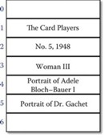
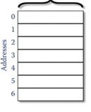
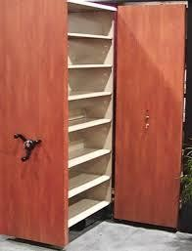
Lists – Storage organization
Data is stored at some location and each location has an address ( Figure:
Storage Organization).
Figure: List of Five painting records
Figure : Storage Organization
Each piece of data is located at an address ( Figure: List of Five painting records).

Slide 12
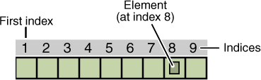
Lists - Indices
Addresses in lists are numbers (indices) as illustrated in Figure: List indices
.
Figure: List indices

Slide 13

Adding Elements to list
Lists can have new entries added anywhere, including in the middle, and
their length can increase as needed.
Original List
  Bohemisn Rhspdody – Queen
  Stairway to Heaven – Led Zeppelin
  Your Song – Elton John
  Who made who – AC/DC
  Sweet Child of Mine – Guns’n Roses
List after adding a new element
Bohemisn Rhspdody – Queen
Every Breath you take - Police
Stairway to Heaven – Led Zeppelin
Your Song – Elton John
Who made who – AC/DC
Sweet Child of Mine – Guns ‘n Roses
The Ghost of Tom Jord – Bruce Springsteen

Slide 14

Removing Elements from List
Entries can be removed from lists.
Original List
  Bohemisn Rhspdody – Queen
  Every Breath you take - Police
  Stairway to Heaven – Led Zeppelin
  Your Song – Elton John
  Who made who – AC/DC
  Sweet Child of Mine – Guns ‘n Roses
  The Ghost of Tom Jord – Bruce Springsteen
List after deletion of two elements
Bohemisn Rhspdody – Queen
Stairway to Heaven – Led Zeppelin
Your Song – Elton John
Who made who – AC/DC
Sweet Child of Mine – Guns‘n Roses

Slide 15
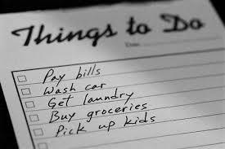
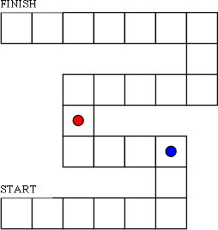
Real Time Applications of lists
We use lists all the time…
Whenever I go shopping.
The "To-Do" list is one of the most common ways that people use to organize their work or studies.
Many simple children's board games are based on list-like structures.

Slide 16
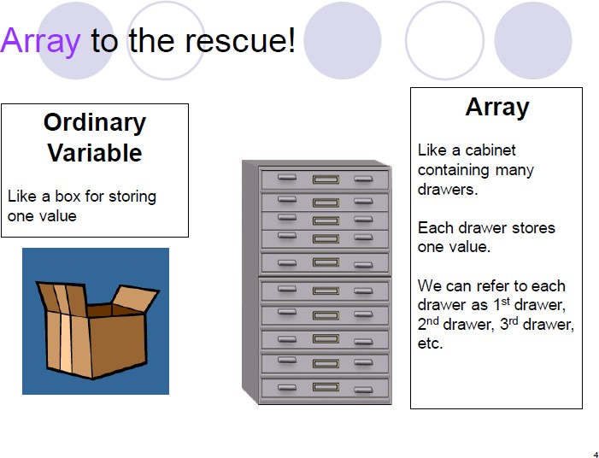
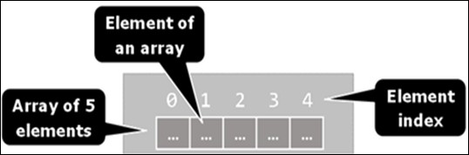
Arrays
Array is a fixed sized list comprising of collections of variables, which we
call elements.
An array’s elements are numbered using indices (Figure: Organization of array)
The total number of elements in a given array is called as the length of an array.
Figure: Organization of array

Slide 17
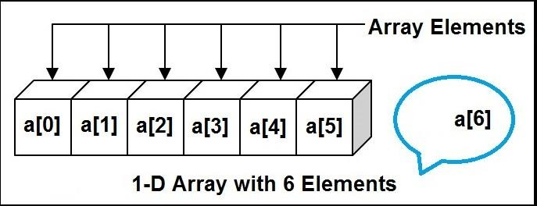
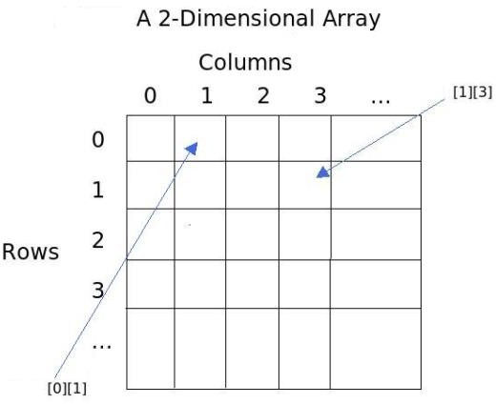
Arrays contd---
All elements of a given array are of the same type.
This allows one to represent a group of similar elements as an ordered sequence and work on them as a whole.
Arrays can be in different dimensions (Figure: A 1-D and 2-D array), but
the most used are the one-dimensional and the two-dimensional arrays.
One-dimensional arrays are also called vectors.
Figure: A 1-D and 2-D array

Slide 18
Array Properties
Arrays have three important properties.
  Arrays represent a group of related data.
(e.g. -- temperature for the last five days, or stock prices for the last 30 days.)
  All data within a single array must share the same data type.
  The size of an array is fixed once it is created.

Slide 19

Declaration/Creation of an Array
Allocate an array with length of specified elements of mentioned type.
During the creation/declaration of the array one must set the total number of the elements in the brackets (a non-negative integer number), defining its length.
Eg. number mark[6], string name[5]
The array cannot change its location nor can it change its length.
The array cannot expand to fill more nor can it shrink to take up less storage.
Figure: mark[6]

Slide 20

Boundaries of an Array
Arrays are by default zero-based, which means the enumeration of the elements starts from 0.
The index of the first element is 0, and that of the second element is 1, and so on.
In an array of N elements, the last element has the index N-1.
Figure: Boundary of myArray is 5

Slide 21
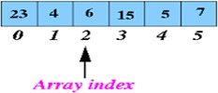
Array element access
We access the array elements directly using their indices.
Each element can be accessed through the name of the array and the element’s index (consecutive number) placed in the brackets.
For Eg. numberArray[2] produces the 3rd element, 6.
Figure: Elements of numberArray

Slide 22

Array element access contd---
As long as we keep track of the location of the array, we will be able to access every item in the array.
The location of the array is known as the base address or the anchor, and is the memory address of the first item in the array.
From a computer's perspective, the name of an array corresponds to the anchor of the array.
  If the name of the array is known, then the anchor is known and all of the array items can be accessed by their index.
  Access elements by….(anchor of array A)+(i-1)
    Can you show how can the elements (4,1, and 6) be accessed from the array Arr=[1,2,3,4,5,6] ?

Slide 23
Answer……
4 arr[3] 1 arr[0] 6 arr[5]

Slide 24
1. Given the array scores,
79 | 87 | 94 | 82 | 67 | 98 | 87 | 81 | 74 | 91
scores
Can you find
How many elements are there?
What is the fifth element in the array?
What is the result of mean = (scores[0]+scores[1])/2
2. Workout the average of Quiz1and student0 with the following data?
Quiz1 Quiz2
Student0 Student1
95 | 85
89 | 80

Slide 25
Answers
How many elements are there? 10
What is the fifth element in the array? 67 What is the result of
mean = (scores[0]+scores[1])/2; (79+87)/2 = 83
Can you workout the average of Quiz1and student0 with the following data??? 92,90

Slide 26


Real time Applications of arrays
A row of houses down one side of a street is organized like an array.
Photo albums are similar to an array. They are “flip albums”, with leaves for holding each photo.

Slide 27




To the array of animals given below show
How to add
How to delete

Slide 28

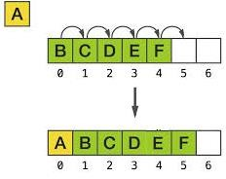
Answer….
Create an empty location by first performing delete
Insert the new element in the desired location by moving the other elements

Slide 29


Consider the payroll task, that requires several pieces of information (hours worked, rate of pay, and regular and over time pay) for the employees of an organization.
Can we organize such data as individual arrays, one for each of the piece of information?
Is this an efficient approach?

Slide 30
Answer….
Consider the payroll task, that requires several pieces of information (hours worked, rate of pay, and regular and over time pay) for the employees of an organization.
Can we organize such data as individual arrays, one for each of the piece of information?Yes
Is this an efficient approach? No because individual single D
Arrays of say… 2 attributes do not capture the relationship between the two attributes… A Multi D array is a better choice

Slide 31
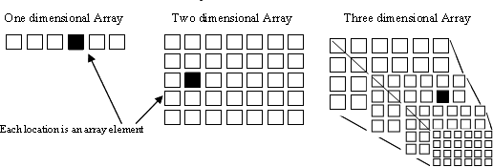
Multi Dimensional Arrays
Although it is useful to have data in one-dimensional arrays, it is sometimes useful to arrange data into rows and columns (two dimensional arrays), rows columns and ranks (three-dimensional), or even higher dimensionality.
A particular cell in a five-dimensional array may be accessed as follows:
Arr_name[dim1][dim2][dim3][dim4][dim5].

Slide 32
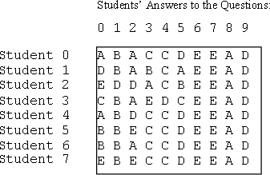
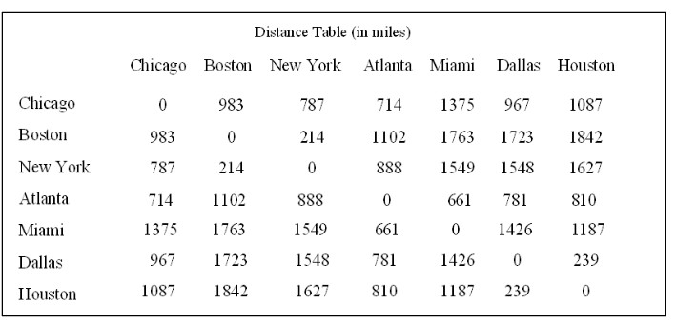
Multi Dimensional Arrays contd---
For eg., if there are eight students and ten questions, and the answers can
be stored in a two-dimensional array as given.
Similarly, the distances between the cities can be represented using a two- dimensional array as given.

Slide 33

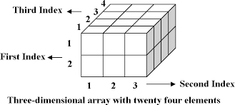



Multi Dimensional Arrays contd---
An array can be declared with multiple dimensions.
2 Dimensional 3 Dimensional
Multiple dimensions get difficult to visualize graphically ( say, from a dot to a cube within a cube) .
•

Slide 34
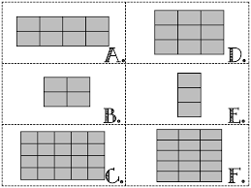
Can you specify the dimension of the array and show how individual elements can be accessed?
Can you show the pictorial representation of the memory associated with an array named a containing 10 integers?
Can you model an array to store the datebook information (specify the dimension, number of indices, show how to access, modify a particular entry of the datebook)?

Slide 35
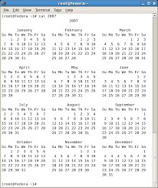
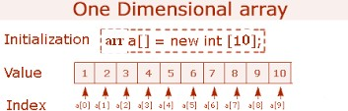
Answer….
A. 2X4
3X3
1X3
5X3
2X2
4X5
Model using one 2D array for storing days of a particular month
Locate an entry using 3 dimensions and update ….. E.g. cal[2015][10][3]

Slide 36
Organizing data
Humans hate disorder.
We try and organise our lives, our cities, our homes and even sometimes
our desks and our bedrooms.
There are many ways of organising things, and we naturally organise different things in different ways.
The organisation we use depends on the things we are trying to organise and often more importantly, what we actually wish to do with them once they are organised.
  Addresses are organised into postal areas so that it is easier for letters to be delivered.
  A bookshop organises its novels on the shelves usually alphabetically by author.
The way we organise the things we must manipulate to achieve a task can make a massive difference to how quickly, easily or successfully the task can be done.
Department of CSE

Slide 37
Game of Spit Not So (Berlekamp et al, 1982)
The game is played as follows by two players:
Write the nine words: SPIT NOT SO FAT FOP AS IF IN PAN on separate pieces of cards.
The cards are placed face up.
Each player takes it in turns to take a card.
To win you must get all the cards that have the same letter.
  For example if you had picked up the cards SPIT, IF and IN, you would have all the cards containing the letter I so would win.
If all the cards are taken with no one having all of a particular letter then the game is a draw.
Department of CSE

Slide 38
Play a few games to get then idea, then turn the page to see how a suitable organisation will help you play better.
Department of CSE

Slide 39
Before you start to play draw up the following grid, with the words that are on the cards written in the squares shown.
The position of each word is important.
They have been organised so that there is a single letter in common in each row, column and diagonal.
All the F-words run along the bottom, for example.
Department of CSE

Slide 40
Keep this hidden from your opponent – otherwise they may see the secret.
Play the game exactly as before, except, now each time you pick up a card, put a cross in the square that corresponds to that word.
Put a nought in the squares corresponding to the cards your opponent takes.
For example, the above game will end with your table looking like the following:
Department of CSE

Slide 41

What has been described?
Arrays and their importance.
Operations on arrays(create, add, delete, locate).
The properties of arrays.
Multi-dimensional arrays.
Credits
Software Solution, Foundation for program design, Lewis and Loftus
Computing Without Computers, A Gentle Introduction to Computer Programming, Data Structures and Algorithms,V ersion 0.15,Paul Curzon
Google images

